Slide 1
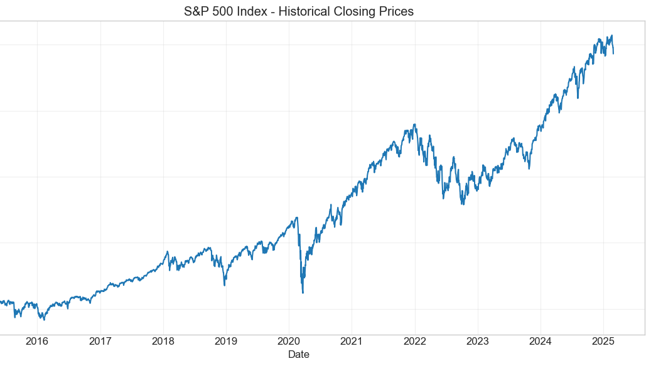

Short-Term S&P 500 Forecasting with ARIMA and GARCH – Key Results
GROUP 16
Notes:
Short-Term S&P 500 Forecasting with ARIMA and GARCH – Key Results
Introduction
Hello everyone! Today we’ll be presenting the key results of our project on short-term forecasting of the S&P 500 index using ARIMA and GARCH models. We wanted to see if combining a model for price trends (ARIMA) with a model for volatility (GARCH) could improve 5-day ahead forecasts of the S&P 500’s closing price. In other words, could we predict the S&P 500’s daily closing prices for a week (Monday through Friday) better than a simple guess? The motivation came from the fact that stock prices often behave like a random walk – they’re hard to forecast because they have no clear pattern and tend to wander unpredictably. Also, we know that while prices drift upward in the long run, daily returns (percentage changes) often show volatility clustering – periods of high volatility followed by high volatility. Our goal was to leverage these insights: use ARIMA to capture any short-term momentum in price changes, and use GARCH to capture the changing volatility, and see if this combined approach yields better accuracy than simpler methods.

Slide 2

Project Objective
Forecast 5 days of S&P 500 closing prices
1
Use ARIMA for price dynamics
2
Use GARCH for volatility
3
Compare models to naive forecast & actuals
4

Slide 3
ARIMA and GARCH
ARIMA: captures autocorrelation in returns
ARIMA(2,1,2)
GARCH: models changing volatility over time
GARCH(1,1)
AR(1)-GARCH(1,1)

Slide 4
Key Results – Model Performance
Metric | ARIMA | GARCH
RMSE | 170.9 | 187.7
MAPE | 2.74% | 3.01%
R² | -10.32 | -12.65

Slide 5
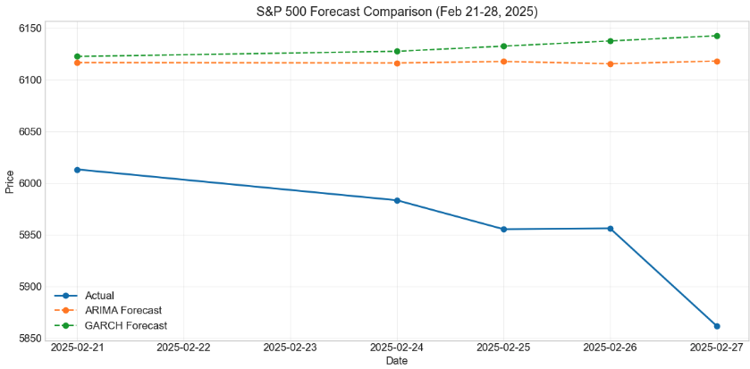
Actual vs Forecasted Prices
Line chart showing:
Actual prices
ARIMA forecasts
GARCH forecasts

Slide 6

What Worked & What Didn’t Work
Worked
Didn’t Work
ARIMA captured short-term autocorrelations in returns.
GARCH captured volatility clustering
Standard financial patterns were confirmed: non-stationarity in prices and volatility in returns.
No model beat naive forecast
GARCH didn’t improve point forecasts
Heavy tails not captured by normal GARCH(1,1) with normal residuals

Slide 7

Lessons Learned
Markets are extremely hard to predict short-term
Complex models don’t always perform better
Naive benchmarks are important reality checks

